Slide 1
Chapter 3:
Memory
Management
Operating System (OS)
Asst. Prof. Jhumi Thapa
Computer Engineering Department

Slide 2
Memory Management and Organization
Memory management is the functionality of an operating system which handles or manages primary memory and moves processes back and forth between main memory and disk during execution.
The part of OS that manages the memory hierarchy is called memory manager.
Memory Organization
Memory unit is the collection of storage units or devices together. The memory unit stores the binary information in the form of bits. Generally, memory/storage is classified into 2 categories:
  Volatile Memory: This loses its data, when power is switched off.
  Non-Volatile Memory: This is a permanent storage and does not lose any data when power is switched off.

Slide 3
What is Memory Hierarchy?
The hierarchical arrangement of storage in current computer architectures is called the memory hierarchy.
Register
L1 Cache
L2 Cache
Main Memory
Local secondary storage (Magnetic Disk)
Remote secondary storage (Magnetic tape)
Faster
Expensive
Less Capacity
Slower
Cheaper
More Capacity

Slide 4
Memory Hierarchy
Internal register is for holding the temporary results and variables. Accessing data from these registers is the fastest way of accessing memory.
Cache is used by the CPU for memory which is being accessed over and over again. Instead of pulling it every time from the main memory, it is put in cache for fast access. It is also a smaller memory, however, larger than internal register.
Main memory or RAM (Random Access Memory): It is a type of the computer memory and is a hardware component. It can be increased provided the operating system can handle it.
Hard disk: A hard disk is a hardware component in a computer. Data is kept permanently in this memory. Memory from hard disk is not directly accessed by the CPU, hence it is slower. As compared with RAM, hard disk is cheaper per bit.
Magnetic tape: Magnetic tape memory is usually used for backing up large data. When the system needs to access a tape, it is first mounted to access the data. When the data is accessed, it is then un-mounted. The memory access time is slower in magnetic tape and it usually takes few minutes to access a tape.

Slide 5
Storage Organization and Management
By storage organization we mean the manner in which the main storage is viewed.
For example – Do we place only a single user in the main storage, or do we place several users in it at the same time? If several user programs are in main storage at the same time, do we give each of them the same amount of space, or do we divide main storage in to portions, called partitions of different sizes? etc.
Storage Management
Regardless of what storage organization scheme we adopt for a particular system, we must decide what strategies to use to obtain optimal performance. Storage management strategies determine how a particular storage organization performs under various policies.
For example – when do we get a new program to place in the memory? Do we get it when the system specifically asks for it, or do we attempt to anticipate the system’s request? Where in the main storage do we place the next program to be run? Etc.
Systems have been implemented using each of these storage management strategies.

Slide 6
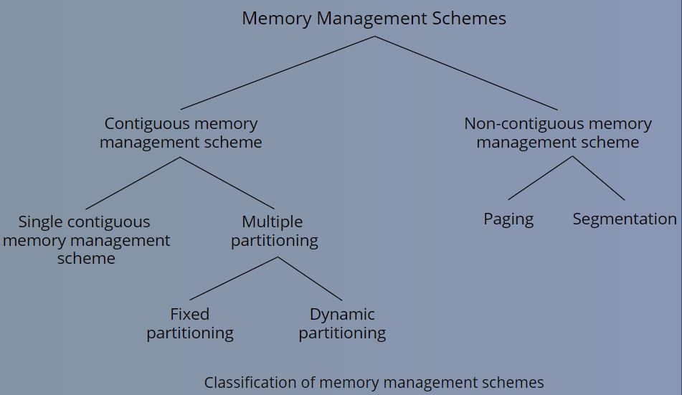
Memory Management Techniques

Slide 7
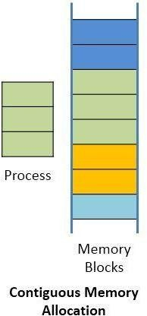
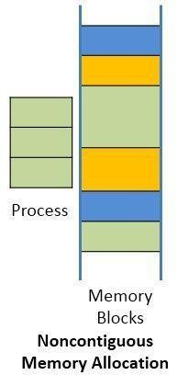
Storage Allocation
The process of allocating the block of memory to a process is known as storage allocation. Memory is a large array of bytes, where each byte has its own address. The memory allocation can be classified into two methods:
  Contiguous Memory Allocation:
    In contiguous memory allocation, when a process requests for the memory, a single contiguous section of memory blocks is assigned to the process according to its requirement.
    The contiguous memory allocation can be achieved by dividing the memory into the fixed- sized partition and allocate each partition to a single process only. But it leads to internal fragmentation.
  Non-contiguous memory:
    In noncontiguous storage allocation, a program is divided into several blocks or segments that may be placed throughout main storage in pieces not necessarily adjacent to one another.
    It reduces the memory wastage caused due to internal and external fragmentation
Notes:
Contiguous memory allocation:
Contiguous memory allocation is basically a method in which a single contiguous section/part of memory is allocated to a process or file needing it. Because of this all the available memory space resides at the same place together, which means that the freely/unused available memory partitions are not distributed in a random fashion here and there across the whole memory space.
Non-contiguous memory allocation:
Non-Contiguous memory allocation is basically a method on the contrary to contiguous allocation method, allocates the memory space present in different locations to the process as per it’s requirements. As all the available memory space is in a distributed pattern so the freely available memory space is also scattered here and there. This technique of memory allocation helps to reduce the wastage of memory, which eventually gives rise to Internal and external fragmentation.

Slide 8
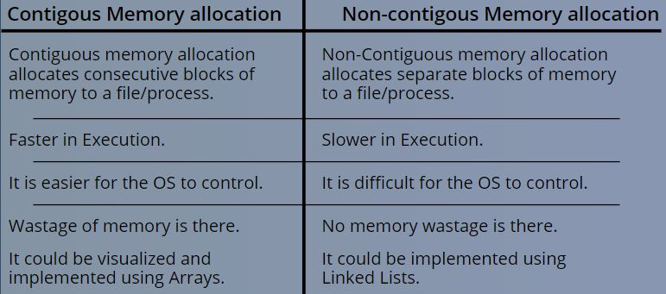
Difference between Contiguous and Non-contiguous Memory Allocation

Slide 9
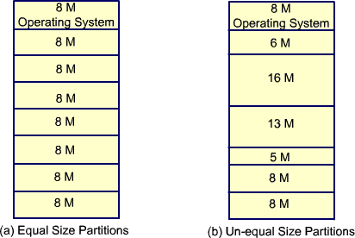
Partitioning
Partitioning
Partitioning is the process of breaking the main memory into number of blocks. Partitioning is of two types:
Fixed/Static Partition Allocation
Number of the partitions are fixed
Size of each partition may be equal sized or unequal sized.
Contiguous allocation so spanning is not allowed.

Slide 10
Fixed/Static Partition Allocation
Any program, no matter how small, occupies an entire partition. This phenomenon, in which there is wasted space internal to a partition due to the fact that the block of data loaded is smaller than the partition, is referred to as internal fragmentation.
Even though we have the availability of memory in different slots we cannot added all the space and accommodate another process. This phenomenon is External Fragmentation.
Notes:
Contiguous allocation so spanning(portion of one process cannot be used by another) is not allowed.
So waste huncha memory space n internal fragmentation huncha

Slide 11
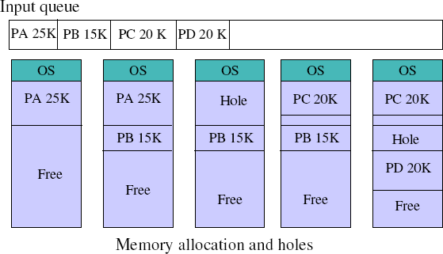
Variable/Dynamic Partition Allocation
To overcome some of the difficulties with fixed partitioning, an approach known as dynamic partitioning was developed
The partitions are of variable length and number. When a process is brought into main memory, it is allocated exactly as much memory as it requires and no more
Holes (pieces of free memory) might be created during dynamic partitioning.
Given a new process, the OS must decide which hole to use for new process

Slide 12
Variable/Dynamic Partition Allocation
Frequent loading and unloading of programs causes free space to be broken into little pieces
Eventually it leads to a situation in which there are a lot of small holes in memory. As time goes on memory becomes more and more fragmented, and memory utilization declines. This phenomenon is referred to as external fragmentation.
External fragmentation exists when there is enough memory to fit a process in memory, but the space is not contiguous.

Slide 13
Fragmentation and Types of Fragmentation
Fragmentation refers to the condition of a disk in which files are divided into pieces scattered around the disk.
Fragmentation occurs naturally when you use a disk frequently, creating, deleting, and modifying files.
External Fragmentation – total memory space exists to satisfy a request, but it is not contiguous.
Internal Fragmentation – allocated memory may be slightly larger than requested memory; this size difference is memory internal to a partition, but not being used.

Slide 14
Swapping
We can use swapping to run multiple programs concurrently.
The process of bringing in each process in its entirely in to memory, running it for a while and then putting it back on the disk is called swapping.
Swapping is a mechanism in which a process can be swapped temporarily out of main memory (or move) to secondary storage (disk) and make that memory available to other processes.
0xFFF…
User Program
Swapped out
Hard Disk
Swapped in
OS in RAM
0

Slide 15
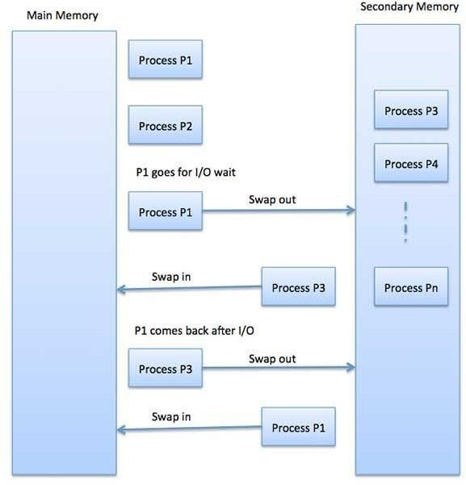
Swapping
Example: In round-robin CPU-scheduling algorithm, when a quantum expires, the memory manager will swap out that process to swap another process into the memory space that has been freed.
The total time taken by swapping process includes the time it takes to move the entire process to a secondary disk and then to copy the process back to memory, as well as the time the process takes to regain main memory

Slide 16
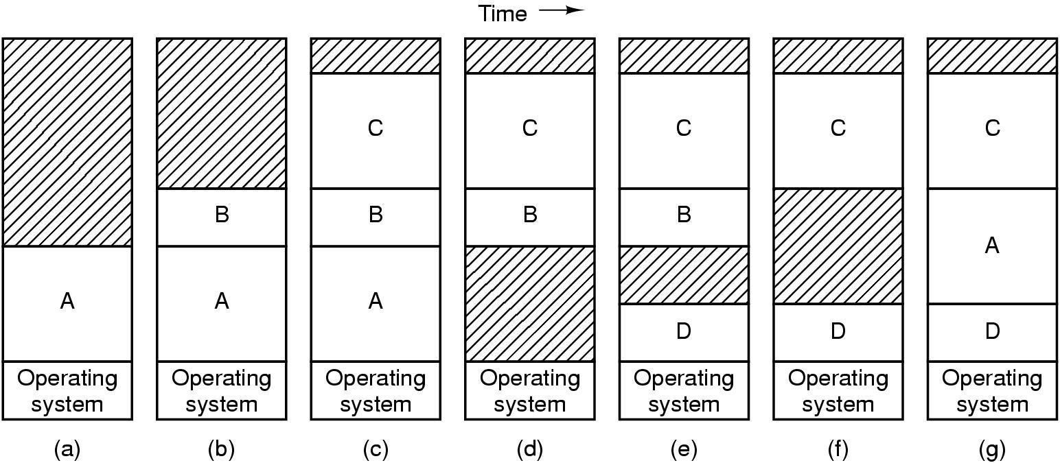
Swapping

Slide 17
Relocation and Protection
Relocation
  Programmers typically do not know in advance which other programs will be resident in main memory at the time of execution of their Program
  Active processes need to be able to be swapped in and out of main memory in order to maximize processor utilization
  Specifying that a process must be placed in the same memory region when it is swapped back in would be limiting may need to relocate the process to a different area of memory
Protection
  Processes need to acquire permission to reference memory locations for reading or writing purposes
  Location of a program in main memory is unpredictable
  Memory references generated by a process must be checked at run time
  Mechanisms that support relocation also support protection

Slide 18
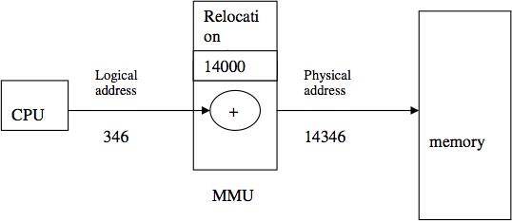
Logical and Physical Memory
Logical memory defines way to organize the physical memory such as RAM and cache.
Physical memory refers to the actual RAM of the system, which usually takes the form of cards attached onto the motherboard.
An address generated by the CPU is commonly referred to as a logical address, whereas an address seen by the memory unit-that is, the one loaded into the memory-address register of the memory-is commonly referred to as a physical address.
Logical and physical addresses are the same in compile-time and load-time address-binding schemes; logical (virtual) and physical addresses differ in execution-time address-binding scheme.

Slide 19
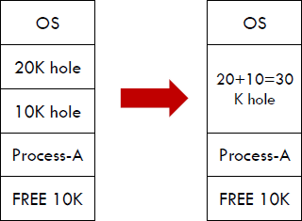
Coalescing
The process of merging two adjacent holes to form a single larger hole is called coalescing.

Slide 20
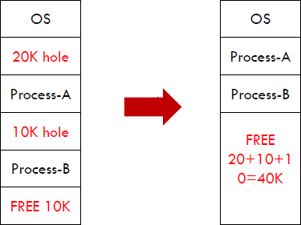
Compaction
Compaction
  Even when holes are coalesced, no individual hole may be large enough to hold the job, although the sum of holes is larger than the storage required for a process. It is possible to combine all the holes into one big one by moving all the processes downward as far as possible; this technique is called memory compaction.

Slide 21
Managing free memory
Two ways to keep track of memory usage (free memory)
  Memory management with Bitmaps
  Memory management with Linked List

Slide 22
Memory management with Bitmaps
A |  |  |  | B | C |  |  | D | E |  |  |  | …….
0
8
16
24
32
1 | 1 | 1 | 1 | 1 | 0 | 0 | 0
1 | 1 | 1 | 1 | 1 | 1 | 1 | 1
1 | 1 | 0 | 0 | 1 | 1 | 1 | 1
1 | 1 | 1 | 1 | 1 | 0 | 0 | 0
With bitmap, memory is divided into allocation units.
Corresponding to each allocation unit there is a bit in a bitmap.
Bit is 0 if the unit is free and 1 if unit is occupied.
The size of allocation unit is an important design issue, the smaller the size, the larger the bitmap.
The main problem is that when it has been decided to bring a k unit process, the memory manager must search the bitmap to find a run of k consecutive 0 bits in the map.
Searching a bitmap for a run of a given length is a slow operation.
: :

Slide 23
Memory management with Linked List
Another way to keep track of memory is to maintain a linked list of allocated and free memory segments, where segment either contains a process or is an empty hole between two processes.
Each entry in the list specifies a hole (H) or process (P), the address at which it starts the length and a pointer to the next entry.
The segment list is kept sorted by address.
Sorting this way has the advantage that when a process terminates or is swapped out, updating the list is straightforward.
A terminating process normally has two neighbors (except when it is at the very top or bottom of memory).
P | 0 | 5
H | 5 | 3
P | 8 | 6
P | 14 | 4
H | 18 | 2
P | 20 | 6
P | 26 | 3
H | 29 | 3 | X
Hole
Starts at 18
Length 2
Process

Slide 24
Memory management with Linked List
P | 0 | 5
H | 5 | 3
P | 8 | 6
P | 14 | 4
H | 18 | 2
P | 20 | 6
P | 26 | 3
H | 29 | 3 | X
Neighbors
Before P terminate
After P terminate
A | P | B
P is replaced by H
A |  | B
P is replaced by H
and two H are merged
A | P
A
P is replaced by H
and two H are merged
 | P | B
 | B
P is replaced by H
and three H are merged
 | P

Slide 25
Memory Allocation Policies
Four memory allocation algorithms are as follow
  First fit
  Next fit
  Best fit
  Worst fit

Slide 26
First fit
Search starts from the starting location of the memory.
First available hole that is large enough to hold the process is selected for allocation.
The hole is then broken up into two pieces, one for process and another for unused memory.
Example: Processes of 212K, 417K, 112K and 426K arrives in order.
Here process of size 426k will not get any partition for allocation.
Advantage: Fastest algorithm because it searches as little as possible.
Disadvantage: Memory loss is higher, as very large hole may be selected for small process.
100k
500k
200k
300k
600k
100k
500k
288k
176k
200k
300k
600k
183k
212k
112k
417k

Slide 27
Next fit
It works in the same way as first fit, except that it keeps the track of where it is whenever it finds a suitable hole.
The next time when it is called to find a hole, it starts searching the list from the place where it left off last time.
Example: Processes of 212K, 417K, 112K and 426K arrives in order.
Here process of size 426k will not get any partition for allocation.
Advantage: Search time is smaller.
Disadvantages : Memory manager must have to keep track of last allotted hole to process.
It gives slightly worse performance than first fit.
100k
500k
200k
300k
600k
100k
500k
288k
200k
300k
600k
183k
71k
212k
417k
112k

Slide 28
Best fit
Entire memory is searched here.
The smallest hole, which is large enough to hold the process, is selected for allocation.
Example: Processes of 212K, 417K, 112K and 426K arrives in order.
Disadvantage: Search time is high, as it searches entire memory every time.
Advantage: Memory loss is less.
100k
500k
200k
300k
600k
100k
500k
83k
200k
88k
300k
88k
600k
174k
417k
112k
212k
426k

Slide 29
Worst fit
Entire memory is searched here also. The largest hole, which is largest enough to hold the process, is selected for allocation.
Example: Processes of 212K, 417K, 112K and 426K arrives in order.
Here process of size 426k will not get any partition for allocation.
Disadvantage : Search time is high, as it searches entire memory every time.
This algorithm can be used only with dynamic partitioning.
100k
500k
200k
300k
600k
100k
500k
83k
200k
300k
600k
388k
276k
417k
212k
112k

Slide 30
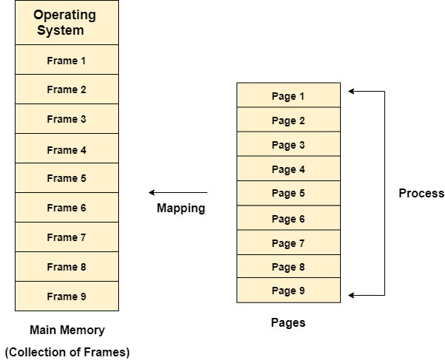
Paging
Paging is a storage mechanism used to retrieve processes from the secondary storage (Hard disk) into the main memory (RAM) in the form
of pages.
Partition memory into small equal fixed-size
chunks and divide each process into the same
size chunks.
The chunks of a process are called pages.
The chunks of memory are called frames.
The main idea behind the paging is to divide each process in the form of pages. The main memory will also be divided in the form of frames.
One page of the process is to be stored in one of the frames of the memory.

Slide 31
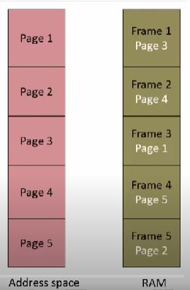
Paging

Slide 32
Paging
The pages can be stored at the different locations of the memory but the priority is always to find the contiguous frames or holes.
Pages of the process are brought into the main memory only when they are required otherwise they reside in the secondary storage.
The sizes of each frame must be equal. Considering the fact that the pages are mapped to the frames in Paging, page size needs to be as same as frame size.
Different operating system defines different frame sizes.
When a process requests memory, the operating system allocates one or more frames to the process and maps the process’s logical pages to the physical frames.
The mapping between logical pages and physical frames is maintained by the page table, which is used by the memory management unit to translate logical addresses into physical addresses.
The page table maps each logical page number to a physical frame number.

Slide 33
Paging
Process 4
Frame 12
Frame 11
Frame 10
Frame 9
Frame 8
Frame 7
Frame 6
Frame 5
Frame 4
Frame 3
Frame 2
Frame 1
Process 3
Page 3
Page 2
Page 1
Page 3
Page 2
Page 1
Process 1 and process 4 are moved out from memory and process 5 enters into memory.
Process 1
Process 2
Page 3
Page 2
Page 1
Page 3
Page 2
Page 1

Slide 34
Paging
Process 5
Frame 12
Frame 11
Frame 10
Frame 9
Frame 8
Frame 7
Frame 6
Frame 5
Frame 4
Frame 3
Frame 2
Frame 1
Process 3
Page 6
Page 5
Page 4
Page 3
Page 2
Page 1
Page 3
Page 2
Page 1
Process 2
We have 6 non contiguous frames available in the memory and paging provides the flexibility of storing the process at the different places.
Page 3
Page 2
Page 1

Slide 35
Logical Address and Physical Address
Logical address
An address generated by the CPU is commonly known as Logical address.
  When we give the problem to the computer then our computer passes the problem to the processor through logical address, which we are not seen, this address called logical address. And the set of all logical addresses generated by a program is known as logical address Space.
Physical address
An address actually available on memory is known as Physical address.
  When our processor create process and solve our problem then we store data in secondary memory through address called physical address. In simple word the address seen by the memory unit that is one loaded into the memory address register of the memory is commonly refereed as the Physical Address. And the set of all physical addresses corresponding to these logical addresses is physical address space.

Slide 36
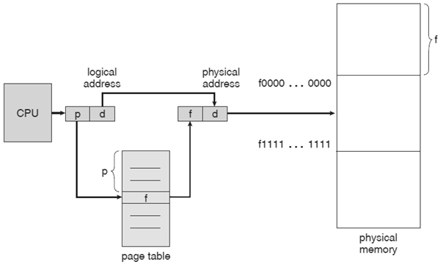
Paging
OS needs to do two things
  Mapping the pages to frame, maintain a page table
  Translate the virtual address (contiguous) into physical address (not so easy as the physical address for a process is scattered all over the memory)
Address generated by CPU (logical address) is divided into:
  Page number p is an index into a page table that contains base address of each page in physical memory.
  Page offset d is a displacement, combined with base address to define the physical memory address that is sent to the memory unit.
Figure: Hardware Support Block diagram for Paging in Operating System

Slide 37
Page table
Page table is a data structure which translates virtual address into equivalent physical address.
The virtual page number is used as an index into the Page table to find the entry for that virtual page and from the Page table physical page frame number is found.
Thus the purpose of page table is to map virtual pages onto page frames.
The page table of the process is held in the kernel space.

Slide 38
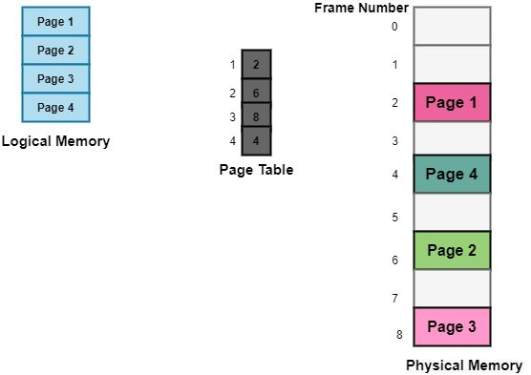
Page Tables
The data structure that is used by the virtual memory system in the operating system of a computer in order to store the mapping between physical and logical addresses is commonly known as Page Table.
The logical address that is generated by the CPU is translated into the physical address with the help of the page table.
Thus page table mainly provides the corresponding frame number (base address of the frame) where that page is stored in the main memory.
Figure: Paging model of Physical and logical memory

Slide 39
Virtual address space is large, the page table will be large
  Types of Page Table
  Multilevel Page Table(Hierarchical Page table)
  Inverted Page Table
  Shared page Table
Three different ways to deal with large page table problems:

Slide 40
Multilevel Page Table
Another name for Hierarchical Paging is multilevel paging.
There might be a case where the page table is too big to fit in a contiguous space, so we may have a hierarchy with several levels.
In this type of Paging the logical address space is broke up into Multiple page tables.
Hierarchical Paging is one of the simplest techniques and for this purpose, a two-level page table and three-level page table can be used.

Slide 41
Multilevel Page Table
Logical Address
PT1
10 bit
PT2
10 bit
Offset
12 bits
F202
D
Physical Address
2
P2
Page | Frame
P1 | F101
P2 | F102
Memory
CPU
Page | Pointer
1
2
3
Page | Frame
P1 | F201
P2 | F202
Page | Frame
P1 | F301
P2 | F302

Slide 42
Inverted Page Table
The Inverted Page table basically combines A page table and A frame table into a single data structure.
There is one entry for each virtual page number and a real page of memory
And the entry mainly consists of the virtual address of the page stored in that real memory location along with the information about the process that owns the page.
Though this technique decreases the memory that is needed to store each page table; but it also increases the time that is needed to search the table whenever a page reference occurs.

Slide 43
Inverted Page Table
Current process ID - 245
Process IDs do not match.
So follow chaining pointer
Page No 2 | Offset
Frame No | Page No | Process ID | Pointer
1 | 2 | 211
2
3
4 | 2 | 245
5
6
Hash Function
Process IDs match.
So frame no added to physical address.
Frame No 4 | Offset
Physical Address

Slide 44
Inverted Page Table
Each entry in the page table contains the following fields.
  Page number – It specifies the page number range of the logical address.
  Process id – An inverted page table contains the address space information of all the processes in execution.
    Since two different processes can have similar set of virtual addresses, it becomes necessary in Inverted Page Table to store a processID of each process to identify it’s address space uniquely.
    This is done by using the combination of PID and Page Number. So this Process Id acts as an address space identifier and ensures that a virtual page for a particular process is mapped correctly to the corresponding physical frame.
  Control bits – These bits are used to store extra paging-related information. These include the valid bit, dirty bit, reference bits, protection and locking information bits.
  Chained pointer – It may be possible sometime that two or more processes share a part of main memory.
    In this case, two or more logical pages map to same Page Table Entry then a chaining pointer is used to map the details of these logical pages to the root page table.

Slide 45
Shared Page Table
The primary purpose of sharing page table is improve performances for large applications that share big memory areas between multiple processes.
It eliminates the redundant page tables and significantly reduces the number of minor page fault.
Here, pages may be shared by multiple processes.

Slide 46
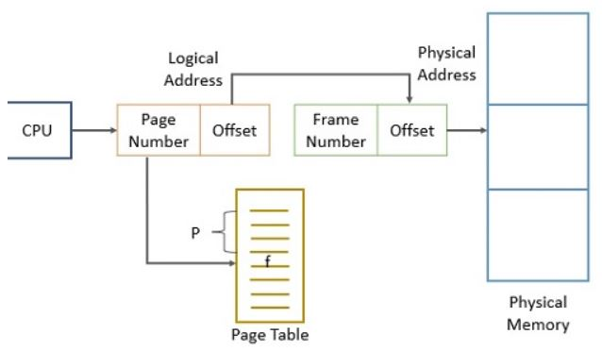
How Does Paging Works?
Paging divides the main memory into fixed-size blocks that we refer to as frames. And the program is divided into blocks of the same size as frames and we refer to them as pages.
When the system has to execute a process, it loads the pages of the program into available frames of main memory. Now to start the execution of a process CPU generates a logical address. The logical address includes page number (p) and page offset (d).
The system uses the page number as an index to trace the page table which has the base address of each page in the main memory i.e., frame (f). The base address (f) is then combined with the page offset (d) to compute the page’s physical address in the block of the main memory.
Figure: Paging Hardware

Slide 47
Advantages and Disadvantages of Paging
Advantages of Paging
  Paging enables the system to allocate non-contiguous memory space to the process.
  As pages and frames are of equal size swapping between them becomes very easy.
  Paging supports the concept of virtual memory.
  Paging is helpful when we have limited main memory.
  With the concept of paging, we do not require external fragmentation.
Disadvantages of Paging
  Paging leads to internal fragmentation.
  The system has to maintain a page table that helps in translating the logical address provided by the CPU into the physical address where the page is stored. But the page tables consume additional space in the system.
  To access the pages from the frames (main memory) the system has to first access the page table which ultimately increases the memory access time.
  For each process, the system needs to maintain a separate page table.

Slide 48
Translation look-aside buffer (TLB)
A translation look-aside buffer (TLB) is a memory cache that stores recent translations of virtual memory/logical to physical addresses for faster retrieval.
TLB contains page table entries that have been most recently used
Given a virtual address, the processor examines the TLB if a page table entry is present (TLB hit), the frame number is retrieved and the real address is formed.
If a page table entry is not found in the TLB (TLB miss), the page number is used as an index while processing the page table. TLB first checks if the page is already in main memory, if not in main memory a page fault is issued then the TLB is updated to include the new page entry.
When an address is searched in the TLB and not found, the physical memory must be searched with a memory page crawl operation. As virtual memory addresses are translated, values referenced are added to TLB.

Slide 49
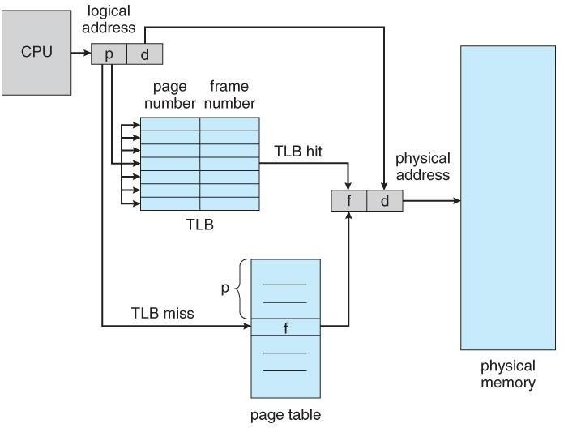
Translation look-aside buffer (TLB)

Slide 50
Mapping from virtual address to physical address using TLB
Logical Address
P
D
F3
Physical Address
F1
D
P3
P2
TLB
Memory
Page | Frame
P1 | F2
P2 | F3
CPU
Hardware
Page Table
Page | Frame
P1 | F2
P2 | F3
P3 | F1
Data Structure
Inside kernel

Slide 51
Mapping from virtual address to physical address using TLB
Steps in TLB hit:
  CPU generates virtual address.
  It is checked in TLB (present).
  Corresponding frame number is retrieved, which now tells where in the main memory page lies.
Steps in Page miss:
  CPU generates virtual address.
  It is checked in TLB (not present).
  Now the page number is matched to page table residing in main memory.
  Corresponding frame number is retrieved, which now tells where in the main memory page lies.
  The TLB is updated with new Page Table Entry (if space is not there, one of the replacement technique comes into picture i.e either FIFO, LRU or MFU etc).

Slide 52
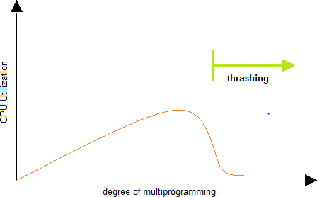
Thrashing
Thrashing is term referred to a high paging activity. A process is thrashing if it is spending more of its time paging than actually executing.
Consider a process that currently needs some more frames. Currently all the frames are occupied. So it will have to swap with certain pages; however, since all the pages are actively being used, there would be need for an immediate page replacement after this. Such a scenario is called thrashing. It results in serious performance problems.

Slide 53
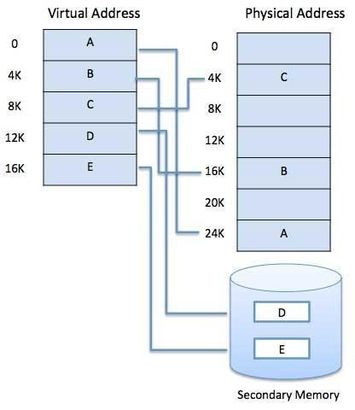
Virtual Memory
A memory management technique that allows programs larger than physical memory to be executed is Virtual Memory.
A computer can address more memory than the amount physically installed on the system. This extra memory is actually called virtual memory.
The run time mapping from virtual address to physical address is done by hardware device called memory management unit (MMU).
Virtual Memory is a space where large programs can store themselves in form of pages while their execution and only the required pages or portions of processes are loaded into the main memory

Slide 54
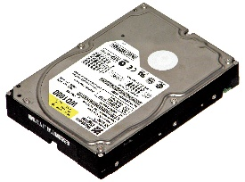
Virtual Memory
Each program has its own address space, which is broken up into pages.
Each page is a contiguous range of addresses.
These pages are mapped onto the physical memory but, to run the program, all pages are not required to be present in the physical memory.
The operating system keeps those parts of the program currently in use in main memory, and the rest on the disk.
In a system using virtual memory, the physical memory is divided into page frames and the virtual address space is divided in into equally-sized partitions called pages.
Virtual memory works fine in a multiprogramming system, with bits and pieces of many programs in memory at once.
RAM
RAM
HDD
RAM
HDD
Another Process’s Memory
RAM
Virtual Address space
HDD

Slide 55
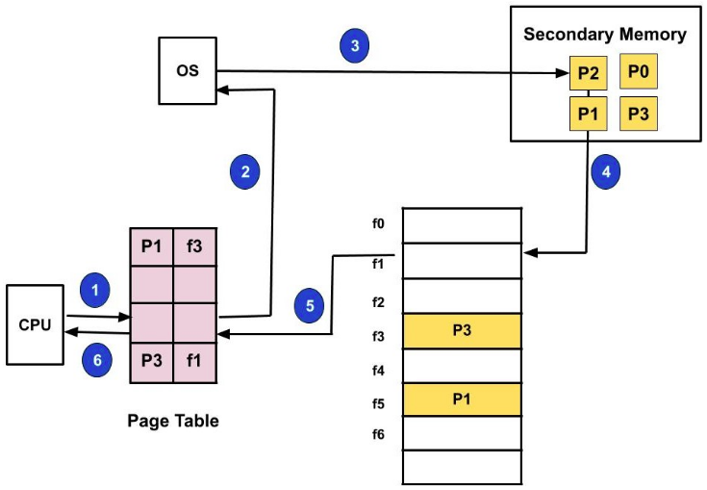
Definitions (Demand paging)
Demand paging: Demand paging is a technique used in virtual memory systems where the pages are brought in the main memory only when required or demanded by the CPU.
Suppose we have to execute a process P having four pages as P0, P1, P2, and P3.
We have page P1 and P3 in the page table.
Now, if the CPU wants to access page P2 of a process P
  search the page in the page table
  P2 is not available in page table so page fault
  OS bring P2 from HDD to RAM
  OS will update page table
  Process P will be executed.

Slide 56
Demand paging
Now, if the CPU wants to access page P2 of a process P, first it will search the page in the page table.
As the page table does not contain this page so it will be a trap or page fault. As soon as the trap is generated and context switching happens and the control goes to the operating system.
The OS system will put the process in a waiting/ blocked state. The OS system will now search that page in the backing store or secondary memory.
The OS will then read the page from the backing store and load it to the main memory.
Next, the OS system will update the page table entry accordingly.
Finally, the control is taken back from the OS and the execution of the process is resumed.
Hence whenever a page fault occurs these steps are followed by the operating system and the required page is brought into memory.

Slide 57
Page Fault and Page Hit
Page Fault:
  When the page (data) requested by a program is not available in the memory, it is called as a page fault. This usually results in the application being shut down.
  A page is a fixed length memory block used as a transferring unit between physical memory and an external storage. A page fault occurs when a program accesses a page that has been mapped in address space, but has not been loaded in the physical memory.
Page hit
Whenever a process refers to a page that is present in memory, such condition is known as page hit.

Slide 58
Page replacement algorithms
Following are different types of page replacement algorithms
  Optimal Page Replacement Algorithm
  FIFO Page Replacement Algorithm
  The Second Chance Page Replacement Algorithm
  The Clock Page Replacement Algorithm
  LRU (Least Recently Used) Page Replacement Algorithm
  NRU (Not Recently Used)

Slide 59
Optimal Page Replacement Algorithm
The moment a page fault occurs, some set of pages will be in the memory.
One of these pages will be referenced on the very next instruction.
Other pages may not be referenced until 10, 100, or perhaps 1000 instructions later.
Each page can be labeled with the number of instructions that will be executed before that page is first referenced.
The optimal page algorithm simply says that the page with the highest label should be removed.
The only problem with this algorithm is that it is unrealizable.
At the time of the page fault, the operating system has no way of knowing when each of the pages will be referenced next.
It simply replace the page which will not used in longest dimension of time in future

Slide 60
Optimal Page Replacement Algorithm
Page Reference String:
  7, 0, 1, 2, 0, 3, 0, 4, 2, 3, 0, 3, 2, 0, 2, 0, 1, 7, 0, 1
  Three frames
Page Request | 7 | 0 | 1 | 2 | 0 | 3 | 0 | 4 | 2 | 3 | 0 | 3 | 2 | 0 | 2 | 0 | 1 | 7 | 0 | 1
Frame – 1 | 7 | 7 | 7 | 2 | 2 | 2 | 2 | 2 | 2 | 2 | 2 | 2 | 2 | 2 | 2 | 2 | 1 | 1 | 1 | 1
Frame – 2 |  | 0 | 0 | 0 | 0 | 0 | 0 | 4 | 4 | 4 | 0 | 0 | 0 | 0 | 0 | 0 | 0 | 0 | 0 | 0
Frame – 3 |  |  | 1 | 1 | 1 | 3 | 3 | 3 | 3 | 3 | 3 | 3 | 3 | 3 | 3 | 3 | 3 | 7 | 7 | 7
Page Faults (9) | F | F | F | F |  | F |  | F |  |  | F |  |  |  |  |  | F | F

Slide 61
FIFO Page Replacement Algorithm
The first in first out page replacement algorithm is the simplest page replacement algorithm.
The operating system maintains a list of all pages currently in memory, with the most recently arrived page at the tail and least recent at the head.
On a page fault, the page at head is removed and the new page is added to the tail.
When a page replacement is required the oldest page in memory needs to be replaced.
The performance of the FIFO algorithm is not always good because it may happen that the page which is the oldest is frequently referred by OS.
Hence removing the oldest page may create page fault again.

Slide 62
FIFO Page Replacement Algorithm
Page Reference String:
  7, 0, 1, 2, 0, 3, 0, 4, 2, 3, 0, 3, 2, 1, 2, 0, 1, 7, 0, 1
  Three frames
Page Request | 7 | 0 | 1 | 2 | 0 | 3 | 0 | 4 | 2 | 3 | 0 | 3 | 2 | 1 | 2 | 0 | 1 | 7 | 0 | 1
Frame – 1 | 7 | 7 | 7 | 2 | 2 | 2 | 2 | 4 | 4 | 4 | 0 | 0 | 0 | 0 | 0 | 0 | 0 | 7 | 7 | 7
Frame – 2 |  | 0 | 0 | 0 | 0 | 3 | 3 | 3 | 2 | 2 | 2 | 2 | 2 | 1 | 1 | 1 | 1 | 1 | 0 | 0
Frame – 3 |  |  | 1 | 1 | 1 | 1 | 0 | 0 | 0 | 3 | 3 | 3 | 3 | 3 | 2 | 2 | 2 | 2 | 2 | 1
Page Faults (15) | F | F | F | F |  | F | F | F | F | F | F |  |  | F | F |  |  | F | F | F

Slide 63
Second Chance Page Replacement Algorithm
It is modified form of the FIFO page replacement algorithm.
It looks at the front of the queue as FIFO does, but instead of immediately paging out that page, it checks to see if its referenced bit is set.
  If it is not set (zero), the page is swapped out.
  Otherwise, the referenced bit is cleared, the page is inserted at the back of the queue (as if it were a new page) and this process is repeated.
Page loaded
first
1
0
1
0
1
Most recently loaded page
A
B
C
D
E
0
1
0
1
0
Remove
B
C
D
E
A
Add at end
1
0
1
0
1
C
D
E
A
F

Slide 64
Second Chance Page Replacement Algorithm
If all the pages have their referenced bit set, on the second encounter of the first page in the list, that page will be swapped out, as it now has its referenced bit cleared.
If all the pages have their reference bit cleared, then second chance algorithm degenerates into pure FIFO.
1
1
1
1
1
A
B
C
D
E
0
0
0
0
0
A
B
C
D
E
0
0
0
0
1
B
C
D
E
F

Slide 65
Clock Page Replacement Algorithm
In second chance algorithm pages are constantly moving around on its list. So it is not working efficiently.
A better approach is to keep all the page frames on a circular list in the form of a clock.
When a page fault occurs, the page being pointed to by the hand is inspected.
  If its R bit is 0, the page is evicted, the new page is inserted into the clock in its place, and the hand is advanced one position.
  If R is 1, it is cleared and the hand is advanced to the next page.
1
A
1
1
0
G
G
F
B
1
A hand points to the oldest page.
1
0
E
C
H
0
1
H
D

Slide 66
LRU (Least Recently Used) Page Replacement Algorithm
A good approximation to the optimal algorithm is based on the observation that pages that have been heavily used in last few instructions will probably be heavily used again in next few instructions.
When page fault occurs, throw out the page that has been used for the longest time. This strategy is called LRU (Least Recently Used) paging.
To fully implement LRU, it is necessary to maintain a linked list of all pages in memory, with the most recently used page at the front and the least recently used page at the rear.
The list must be updated on every memory reference.
Finding a page in the list, deleting it, and then moving it to the front is a very time consuming operations.

Slide 67
LRU (Least Recently Used) Page Replacement Algorithm
Page Reference String:
  7, 0, 1, 2, 0, 3, 0, 4, 2, 3, 0, 3, 2, 1, 2, 0, 1, 7, 0, 1
  Three frames
Page Request | 7 | 0 | 1 | 2 | 0 | 3 | 0 | 4 | 2 | 3 | 0 | 3 | 2 | 1 | 2 | 0 | 1 | 7 | 0 | 1
Frame – 1 | 7 | 7 | 7 | 2 | 2 | 2 | 2 | 4 | 4 | 4 | 0 | 0 | 0 | 1 | 1 | 1 | 1 | 1 | 1 | 1
Frame – 2 |  | 0 | 0 | 0 | 0 | 0 | 0 | 0 | 0 | 3 | 3 | 3 | 3 | 3 | 3 | 0 | 0 | 0 | 0 | 0
Frame – 3 |  |  | 1 | 1 | 1 | 3 | 3 | 3 | 2 | 2 | 2 | 2 | 2 | 2 | 2 | 2 | 2 | 7 | 7 | 7
Page Faults (12) | F | F | F | F |  | F |  | F | F | F | F |  |  | F |  | F |  | F

Slide 68
NRU (Not Recently Used) Page Replacement Algorithm
NRU makes approximation to replace the page based on R (referenced) and M (modified) bits.
When a process is started up, both page bits for all pages are set to 0 by operating system.
Periodically, the R bit is cleared, to distinguish pages that have not been referenced recently from those that have been.
When page fault occurs, the operating system inspects all the pages and divide them into 4 categories based on current values of their R and M bits
  Case 0 : not referenced, not modified
  Case 1 : not referenced, modified
  Case 2 : referenced, not modified
  Case 3 : referenced, modified
The NRU (Not Recently Used) algorithm removes a page at random from the lowest numbered nonempty class.

Slide 69
NRU (Not Recently Used) Page Replacement Algorithm
For example if,
  Page-0 is of class-2 (referenced, not modified)
  Page-1 is of class-1 (not referenced, modified)
  Page-2 is of class-0 (not referenced, not modified)
  Page-3 is of class-3 (referenced, modified)
So lowest class page-2 needs to be replaced by NRU.

Slide 70
Belady’s Anomaly (in FIFO Page Replacement Algorithm)
Page Reference String: 1, 2, 3, 4, 1, 2, 5, 1, 2, 3, 4, 5
Page Faults of 4 Frame > Page Faults of 3 Frame
Page Request | 1 | 2 | 3 | 4 | 1 | 2 | 5 | 1 | 2 | 3 | 4 | 5
Three Frames
Frame – 1 | 1 | 1 | 1 | 4 | 4 | 4 | 5 | 5 | 5 | 5 | 5 | 5
Frame – 2 |  | 2 | 2 | 2 | 1 | 1 | 1 | 1 | 1 | 3 | 3 | 3
Frame – 3 |  |  | 3 | 3 | 3 | 2 | 2 | 2 | 2 | 2 | 4 | 4
Page Faults (9) | F | F | F | F | F | F | F |  |  | F | F
Page Request | 1 | 2 | 3 | 4 | 1 | 2 | 5 | 1 | 2 | 3 | 4 | 5
Frame – 1 | 1 | 1 | 1 | 1 | 1 | 1 | 5 | 5 | 5 | 5 | 4 | 4
Frame – 2 |  | 2 | 2 | 2 | 2 | 2 | 2 | 1 | 1 | 1 | 1 | 5
Frame – 3 |  |  | 3 | 3 | 3 | 3 | 3 | 3 | 2 | 2 | 2 | 2
Frame – 4 |  |  |  | 4 | 4 | 4 | 4 | 4 | 4 | 3 | 3 | 3
Four Frames
Page Faults (10) | F | F | F | F |  |  | F | F | F | F | F | F

Slide 71
Belady’s Anomaly (in FIFO Page Replacement Algorithm)
Belady’s anomaly is the phenomenon in which increasing the number of page frames results in an increase in the number of page faults for certain memory access patterns.
This phenomenon is commonly experienced when using the First-In First-Out (FIFO) page replacement algorithm.
In FIFO, the page fault may or may not increase as the page frames increase, but in Optimal and stack-based algorithms like LRU, as the page frames increase the page fault decreases.

Slide 72
Sum
A computer has four page frames. The time of loading, time of last access and the R and M bit for each page given below. Which page FIFO, LRU and NRU will replace.
Page | Loaded | Last used | R | M
0 | 126 | 280 | 1 | 0
1 | 230 | 265 | 0 | 1
2 | 140 | 270 | 0 | 0
3 | 110 | 285 | 1 | 1
FIFO:- Page which is arrived first needs to be removed first, so page-3 needs to replace.
LRU:- When page fault occurs, throw out the page that has been used for the longest time.
Page-1 is not used for the long time from all four, so LRU suggest replacing page-1.
NRU:-
  Page-0 is of class-2 (referenced, not modified)
  Page-1 is of class-1 (not referenced, modified)
  Page-2 is of class-0 ( not referenced, not modified)
  Page-3 is of class-3 (referenced, modified)
  So lowest class page-2 needs to be replaced by NRU

Slide 73
Segmentation
Process P
Segment Map Table
Segmentation is a memory management technique in which each job is divided into several segments of different sizes, one for each module that contains pieces that perform related functions.
Each segment is actually a different logical address space of the program.
When a process is to be executed, its corresponding segmentation are loaded into non-contiguous memory though every segment is loaded into a contiguous block of available memory.
Segmentation memory management works very similar to paging but here segments are of variable-length where as in paging pages are of fixed size.
Segment 1
Sr | Size | Memory Address
1 | 300 | 100
2 | 500 | 400
3 | 100 | 900
N | X | NM
Physical Memory
100
200
300
400
500
600
700
800
900
1000
1100
Segment 2
Segment 3
Segment N

Slide 74
Segmentation
Process P
Segment Map Table
A program segment contains the program's main function, utility functions, data structures, and so on.
The operating system maintains a segment map table for every process.
Segment map table contains list of free memory blocks along with segment numbers, their size and corresponding memory locations in main memory.
For each segment, the table stores the starting address of the segment and the length of the segment.
A reference to a memory location includes a value that identifies a segment and an offset.
Segment 1
Sr | Size | Memory Address
1 | 300 | 100
2 | 500 | 400
3 | 100 | 900
N | X | NM
Physical Memory
100
200
300
400
500
600
700
800
900
1000
1100
Segment 2
Segment 3
Segment N

Slide 75
Paging VS Segmentation
Paging | Segmentation
Paging was invented to get large address space without having to buy more physical memory. | Segmentation was invented to allow programs and data to be broken up into logically independent address space and to add sharing and protection.
The programmer does not aware that paging is used. | The programmer is aware that segmentation is used.
Procedure and data cannot be distinguished and protected separately. | Procedure and data can be distinguished and protected separately.
Change in data or procedure requires compiling entire program. | Change in data or procedure requires compiling only affected segment not entire program.
Sharing of different procedures not available. | Sharing of different procedures available.

Slide 76
Assignment
Explain multiprogramming with fixed partition.
How free space can be managed by OS.
Explain Swapping and Fragmentation in detail.
What is Paging? Explain paging mechanism in MMU with example.
Explain TLB and Virtual Memory.
Discuss demand paging.
Define following Terms: Thrashing
List different Page Replacement Algorithms? Discuss it in terms of page faults.
What is Belady’s anomaly? Explain with suitable example.
Consider (70120304230321201701) page reference string: How many page fault would occur for following page replacement algorithm. Consider 3 frames and 4 frames.
  1. FIFO 2. LRU 3. Optimal

Slide 77
Assignment
Given six Partition of 300KB, 600KB, 350KB, 200KB, 750KB and 125KB(in order), how would the first-fit, best-fit and worst-fit algorithms places processes of size 115 KB, 500KB, 358KB, 200KB and 375KB(in order)? Which algorithm is efficient for the use of memory?
Calculate the page fault rates for below reference string in case of FIFO and Optimal page replacement algorithm. Assume the memory size is 4 page frames and all frames are initially empty. 0,2,1,6,4,0,1,0,3,1,2,1
Consider the following reference string. Calculate the page fault rates for FIFO and OPTIMAL page replacement algorithm. Assume the memory size is 4 page frame.
1,2,3,4,5,3,4,1,6,7,8,7,8,9,7,8,9,5,4,5,4,2
Consider the page reference string: 1,2,3,4,5,3,4,1,6,7,8,7,8,9,7,8,9,5,4,5,4,2 With four Frames How many page faults would occur for the FIFO, Optimal page replacement algorithms? which algorithm is efficient? (assume all frames are initially empty)

